Slide 1
Shunt Detection and Quantification

Slide 2
History
Our concepts of heart disease are based on the enormous reservoir of physiologic and anatomic knowledge derived from the past 70 years of experience in the cardiac catheterization laboratory.
As Andre Cournand remarked in his Nobel lecture of December 11,1956, the cardiac catheterization was the key in the lock.
By turning this key, Cournand and his colleagues led us into a new era in the understanding of normal and disordered cardiac function in humans

Slide 3
In 1930, Klein reported 11 RT heart catheterizations, including passage to the RV and measurement of cardiac output using Fick's principle.
In 1932, Padillo and coworkers reported right heart catheterization and measurement of cardiac output in two subjects
In 1947, Dexter reported his studies on congenital heart disease
The biggest change in the last 25 years has been the return to the therapeutic potential of the cardiac catheterization.

Slide 5
Shunt: Detection
Localization
Quantification

Slide 6
When to suspect?
1. Unexplained arterial desaturation – suspect R ->L intracardiac shunt
-Arterial SpO2 < 95%
-M.C cause is Alveolar Hypoventilation:-Excess sedation
-COPD
-Pulmonary Edema
-Try head up tilt + Deep breaths / Coughing
-Give 100% O2 via rebreathing mask
If full arterial saturation cannot be achieved, a Right to Left shunt is presumed to be present

Slide 7
2. PA blood oxygen saturation > 80% : Suspect a left to right intracardiac shunt.
3.When data obtained at cardiac catheterization do not confirm the presence of a suspected lesion, one should consider the presence of an intracardiac shunt
Eg- LV angio failing to reveal an MR in a patient with PSM – suspect VSD with left to right shunting

Slide 8
Left to Right Intracardiac shunts
1.Oximetry run
2. Flow ratio
3. Indicator dye dilution technique
4. Angiography

Slide 9
Oximetry Run
Measuring O2 content or percentage saturation in blood samples drawn sequentially from PA, RV, RA, SVC, & IVC
L – RT SHUNT : Detection need “Significant O2 step up” in blood oxygen saturation or content in one of the right heart chamber/PA
Significant Step up : Increase in blood O2 content or saturation that exceeds the normal variability that might be observed if multiple samples were drawn from that cardiac chamber

Slide 10
The technique of the oximetry run is based on the pioneering studies of Dexter and his associates in 1947
Proposed step up at atrial , ventricular , PA level are 2 vol%, 1vol%, 0.5vol%
1 vol% =1 ml O2/100 ml blood, or 10 ml O2/L of blood
Oxygen content was measured by Van Slyke technique , and other manometric studies

Slide 11
Various methods used for oximetry run are
1. Oxygen content
2. Oxygen saturation
Spectrophotometry
Oxygen dissociation curve

Slide 12
Spectrophotometric oximetry is technically easy
Oxygen content is calculated by saturation by
= O2 sat. * Hb % * 1.36
When oxygen content is derived in this manner, rather than by direct oximetric technique, the value is no more accurate (presence of carboxy Hb or Hb variants with O2 capacity other than 1.36)

Slide 13
O2 content vs O2 saturation
Antman EM. Blood oxygen measurements in the assessment of intracardiac left to right shunts: a critical appraisal of methodology. Am J Cardiol 1980
Antman and coworkers – normal variation of both oxygen content and oxygen saturation of blood in the right heart chambers
Pts. without intracardiac shunts who were undergoing diagnostic cath.
Oxygen content and Oxygen saturation was calculated
The relationship between O2 content and O2 saturation depends on the Hb conc in the patient’s blood
Ex 75% O2 saturation of PA blood will be associated with substantially lower O2 content in an anemic patient.

Slide 14
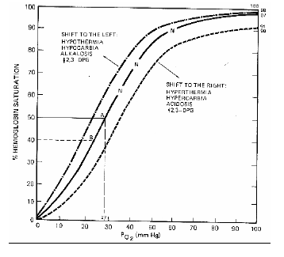
O2 saturation – O2 dissociation curve
Method of saturation calculation
Major disadvantage of dissociation curve is its dependency on other factors

Slide 15
O2 saturation by spectrophotometry
Based on Beers law – the conc of a given solute in a solvent is determined by the amount of light that is absorbed by the solute at a specific wavelength.
Advantages : quick ,accurate, precise , subject to few errors , less dependency on Hb%

Slide 16
Disadvantages :
Inaccurate if large amounts of carboxy hemoglobin is present
Indocyanine green interfere with light source of spectrophotometry
Elevated bilirubin affect absorption of light
1% error at 95% O2 saturation
2.5% error at 70% O2 saturation
O2 saturation spectrophotometry is presently best method for oximetry

Slide 17
Screening for L->R shunt
Take blood samples from SVC and PA
If Δ O 2 saturation between these is ≥8%, a L-> R shunt may be present and a full oximetry run should be done

Slide 18
Procedure of Oximetry Run
2-mL sample from each of the following locations:
Left and/or right pulmonary artery & Main pulmonary artery
Right ventricle, outflow tract, mid & tricuspid valve or apex
Right atrium, low or near tricuspid valve , mid & high
Superior vena cava, low (near junction with right atrium)
Superior vena cava, high (near junction with innominate vein)
Inferior vena cava, high (just at or below diaphragm)
Inferior vena cava, low (at L4-L5)
Left ventricle
Aorta (distal to insertion of ductus)
Confirm location by pressure measurement
If frequent extrasystoles occur, do not persist. Obtain samples from three different locations in RV and RA

Slide 19
In performing the oximetry run, an end-hole catheter (e.g., Swan- Ganz balloon flotation catheter) or one with side holes close to its tip (e.g., a Goodale-Lubin catheter) can be used
Catheter tip position adjusted by pressure measurement
The entire procedure should take less than 7 minutes
If a sample cannot be obtained from a specific site because of ventricular premature beats, that site should be skipped until the rest of the run has been completed

Slide 20
Normal values for O2 saturation

Slide 23
What to do if significant step up detected?
Step 1: Determine MV O2
Step 2: Calculate Qp
Step 3: Calculate Qs
Step 4: Calculate shunt flow
Step 5: Determine Qp/Qs

Slide 24
MV O2 Calculation
The mixed venous oxygen content is the average oxygen content of the blood in the chamber proximal to the left to right shunt
FLAMM FORMULA
MVO2 ( At Rest) = 3 SVC O2 + 1 IVC O2
4
MVO2 ( At Exercise) = 1 SVC O2 + 2 IVC O2
3

Slide 25
Location of shunt as determined by site of O2 step-up | Mixed venous sample to be used in calculatng systemic blood flow
1. PA (e.g., PDA) | RV, avg of samples obtained during oximetry run
2. RV (e.g., VSD) | RA, avg of all samples during oximetry run
3. RA (e.g., ASD) | 3 SVC O2 + 1 IVC O2 4

Slide 26
Calculation of Pulmonary Blood Flow (Qp)
PULMONARY VEIN SATURATION
If a PV not entered and if systemic saturation ≥95% - Use the systemic saturation
If systemic saturation <95%
-Look for R-> L shunt
-If shunt present take PVO2 as 98%
-If no shunt use the observed systemic SpO2

Slide 27
CALCULATION OF SYSTEMIC BLOOD FLOW (Q_{S} )

Slide 28
Calculation of L->R Shunt
If there is no evidence of an associated R-> L shunt, the L->R shunt is calculated by
L->R shunt = Qp – Qs (measured in L/min)

Slide 29
Flow Ratio
The ratio can be calculated from knowledge of blood O2 saturation alone
Qp/ Qs = ( SA O2 – MV O2) / (PV O2 – PA O2)
Qp/Qs ratio:
≥ 2.0 large L->R shunt
Between 1.5 & 2.0 intermediate
< 1.5 small L-> R shunt

Slide 30
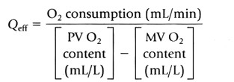
Calculation of bidirectional shunts
Bidirectional shunt makes use of a hypothetic quantity known as effective blood flow, the flow that would exist in the absence of any L-> R or R-> L shunting:
L-> R shunt = Qp - Qeff
R-> L shunt = Qs - Qeff

Slide 31
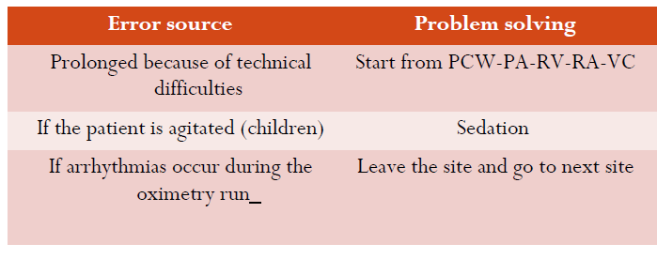
Limitations of oximetry method
Absence of a steady state during the collection of blood samples

Slide 32
2. Lacks sensitivity
3. Antman and coworkers , normal variability of oxygen saturation in right heart chambers influenced by the magnitude of systemic blood flow
High levels of systemic flow tend to equalize the arterial and venous O2 values and therefore elevated SBF will cause the MVO2 to be higher than normal
4. Antman and colleagues , the influence of blood hemoglobin concentration may be important when blood O2 content (rather than O2 saturation) is used to detect a shunt

Slide 33
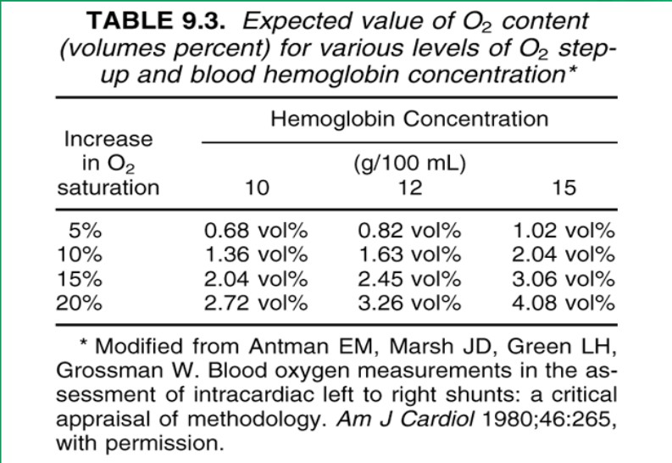

Slide 34
GUIDELINES FOR OPTIMUM USE OF OXIMETRIC METHOD FOR SHUNT DETECTION AND QUANTIFICATION
Blood samples at multiple sites should be obtained rapidly.
The entire procedure should take < 7 Minutes.
Blood O₂ saturation data rather than O₂ content data are preferable
Comparison of the mean of all values obtained in the respective chambers is preferable to comparison of highest values in each chamber
Because of the important influence of SBF on shunt detection exercise should be used in equivocal cases where a low SBF is present at rest

Slide 36
There is a step-up in oxygen saturation in the mid-right atrium.
The average or mean value for the vena caval samples in this patient is calculated as (3 [ SVC] + 1 [ IVC ] )/4.
SVC is the average of SVC samples (i. e . , 67.5% in this example) and IVC is the value for the IVC sample taken at the level of the diaphragm only (i. e . , 73%).
Thus the vena caval mean 02 saturation for the example illustrated in is (3 [ 6 7 . 5 ] + 1 [ 73 ] )/4 = 69% .
The right atrial mean 02 saturation for this patient is (74 + 84 + 79)/3 = 79% .
The 1 0% step-up in mean 02 saturation from vena cava to right atrium is higher than the 7% value listed as a criterion for a significant step-up at the atrial level.

Slide 37
If the patient's 02 consumption is 240 mL 02/minute and the blood hemoglobin concentration is 14 g%, pulmonary and systemic blood flows may be calculated as follows
PV 02 content was not measured, but left ventricular (LV) and arterial blood 02 saturation was 96% and therefore it may be assumed that PV blood 02 saturation was 96%.
PV O2 content may be calculated as:

Slide 38
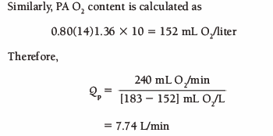
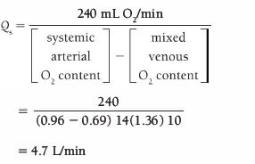
Qp/Qs is 7.7/4.7 = 1.65
Qp-Qs is 7.7 – 4.7 = 3 L/min

Slide 39
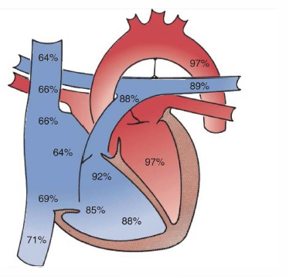
1. what is the level of shunt?
2. what is the direction of shunt?
3. what is the diagnosis?
4. what is Qp/Qs?

Slide 40
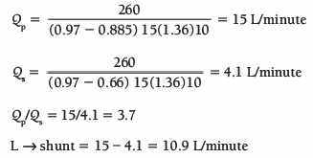
In this case, the patient has a large 02 step-up in the right ventricle, indicating the presence of a ventricular septal defect.
If 02 consumption is 260 ml/minute and hemoglobin is 15 g% , then
In this case, the 02 saturation of mixed venous blood is calculated by averaging the right atrial 02 saturations because the right atrium is the chamber immediately proximal to the 02 step-up.

Slide 41
Indicator dilution technique
Various dyes that are used are
Indocyanine green dye
Inhaled hydrogen , dissolved hydrogen in saline
Freon test
L – krypton – 85
Nitrous oxide test
T - 1824

Slide 42
For detection of left to right shunt dye is injected in to proximal chamber and sample is taken from distal chamber by densitometry and density of dye displayed over time
Usually it is injected in to PA and sampling in the systemic artery
Presence of L – R shunt is detected by early recirculation of dye on the down slope of the curve
In addition to identification curve can also predict the severity of shunt

Slide 43
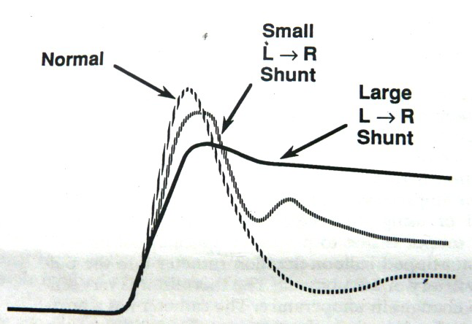
Can detect left to right shunts too small to be detected by the O2 step up method
Thus if there is no evidence of a left to right shunt there is no need to perform an oximetry run
The studies of Castillo and coworkers suggest that left-to-right shunts as small as 25% of the systemic output can be detected by standard pulmonary artery to systemic artery dye curves
Although it may detect the presence of a shunt, it does not localize it

Slide 44
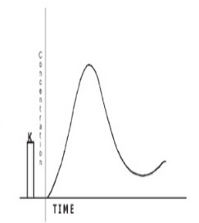
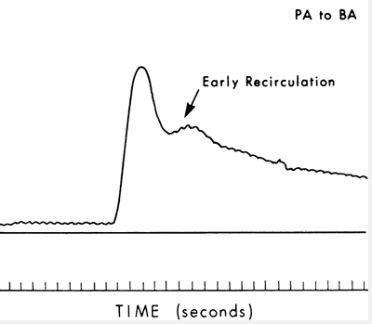
Normal Left to right shunt

Slide 45
Angiography
Effective in visualizing and localizing the siteof left-to-right shunts
Angiographic demonstration of anatomy has become a routine part of the preoperative evaluation of patients with congenital or acquired shunts and is useful in localizing the anatomic site of the shunt

Slide 47
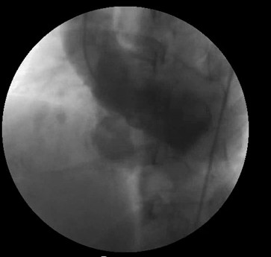
Angiograms in the LAXO in VSD

Slide 48
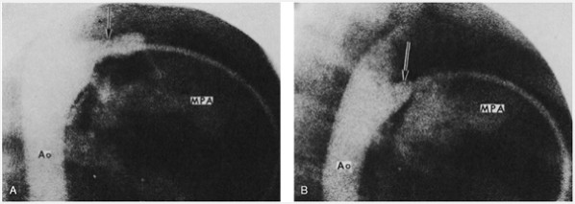
Angiograms in the lateral position in patent ductus arteriosus

Slide 49
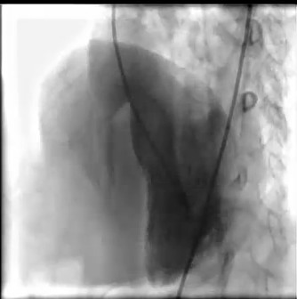
Angiograms in the LAO position in RSOV to RA

Slide 50
Detection of R-> L intracardiac shunts

Slide 51
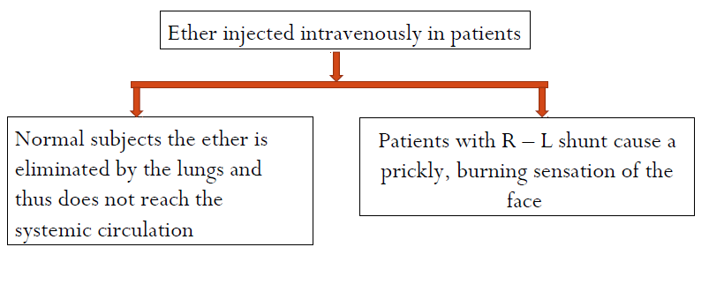
Attempts to measure right-to-left shunts in patients with cyanotic heart disease date back at least to 1941
Prinzmetal , Benenson and Hitzig studied regarding R->L identification

Slide 52
Prinzmetal then measured the time necessary for an intravenous injection of a dilute solution of saccharin to be tasted
This time is equal to the transit time from a peripheral vein through the lungs, through the left heart, and then to the systemic circulation
By increasing the concentration of the saccharin, he found that a second, much shorter appearance time occurred in patients with cyanotic heart disease because of the presence of a right-to-left shunt bypassing the pulmonary circulation.

Slide 53
He estimated the percent right-to-left shunt by the following formula:
where A is the smallest concentration of saccharin to be tasted by way of the long circuit and C is the smallest concentration of saccharin to be tasted by the short circuit

Slide 54
Angiography
Important in detecting R->L shunting caused by a pulmonary AV fistula
In this circumstance, the shunt cannot be detected by indicator- dilution curves on the basis of shortened appearance time
The difference in transit time when the pulmonary capillaries are bypassed is not perceptible by standard indicator – dilution techniques
Angiography may localize R->L shunts, does not permit quantification

Slide 55
Oximetry
Site of R-> L shunts may be localized if blood samples obtained from PV, LA, LV, and aorta
Localized by noting which left heart chamber is the first to show desaturation – step down in O2 concentration
If LA blood O2 sat is normal but desaturation present in LV and aorta, the R-> L shunt is across VSD
Disadvantage: entering PV and LA is not as easy in adults as it is in infants

Slide 56
Echocardiography
Sensitive for the detection of L->R and R->L shunts
Bubble study and echo Doppler techniques are used.

Slide 57
Echocardiographic estimation of Qp/Qs is based on doppler aided calculation of cardiac output as
CO = Mean Velocity x Vessel flow area
Cosine θ
Where θ is the cosine of the incidence angle between Doppler beam and direction of flow

Slide 58
Time velocity integral
Flow velocity can be determined by Doppler imaging
If flow were constant it would be simple matter to calculate velocity
In the cardiovascular system flow is pulsatile and individual velocities during the ejection phase must be sampled and then integrated to measure flow volume.
This sum of velocities – TVI and is equal to area enclosed by the Doppler velocity profile during one ejection period

Slide 59
The preferred sites for determining SV and cardiac output (in descending order of preference) are as follows:
1.The LVOT tract or aortic annulus
2.The mitral annulus
3.The pulmonic annulus

Slide 60
The LVOT is the most widely used site.
SV is derived as: SV = CSA ×VTI
The CSA of the aortic annulus is circular, with little variability during systole.
Because the area of a circle = πr2, the area of the aortic annulus is derived from the annulus diameter (D) measured in the parasternal long axis view as: CSA = D2 ×π/4 = D2 × 0.785

Slide 61
Qp = RVOT CSA× RVOT TVI
Qs = LVOT CSA × LVOT TVI

Slide 62
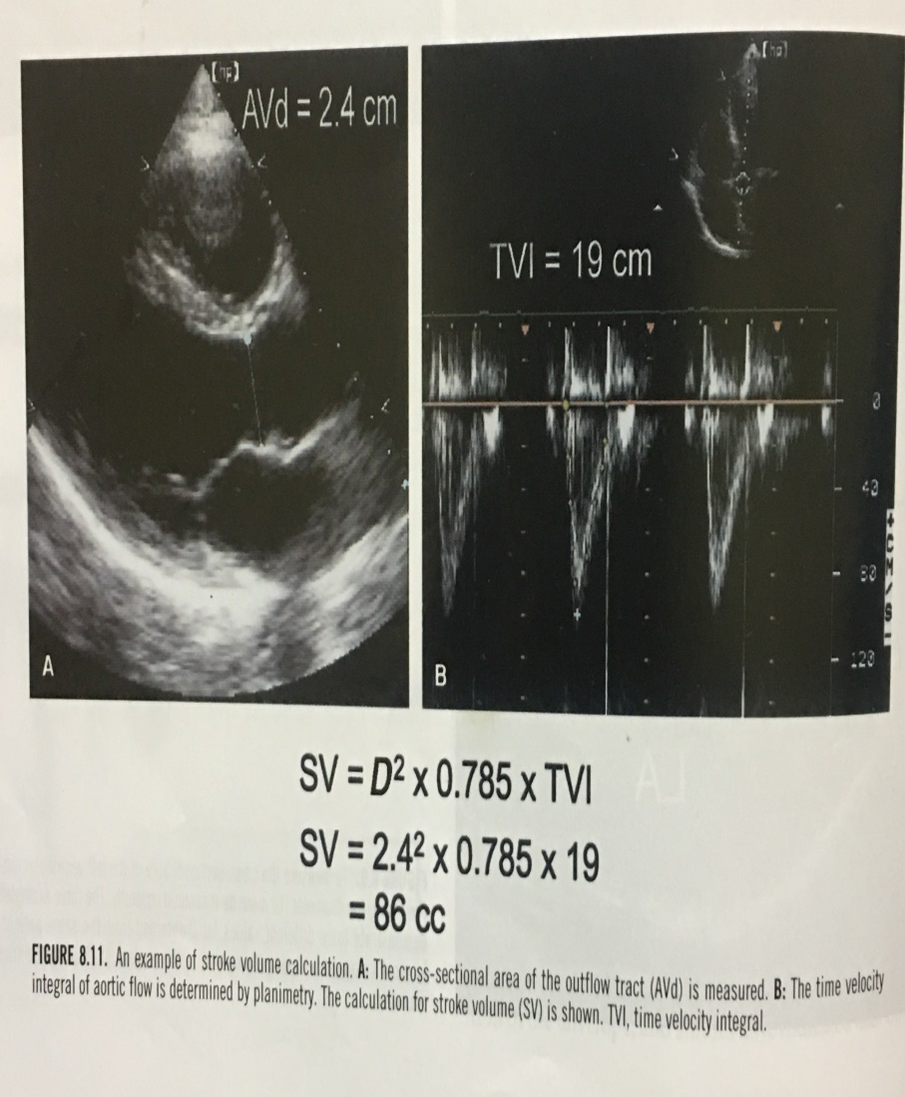
Aortic valve
Measurement of the annulus diameter done during early systole in the parastenal long axis view.
The largest of 3 to 5 measurements should be taken because it likely corresponds to the true diameter.
The LV outflow velocity is recorded from the apical 5- chamber or long-axis view, with the sample volume positioned about 5 mm proximal to the aortic valve.

Slide 63
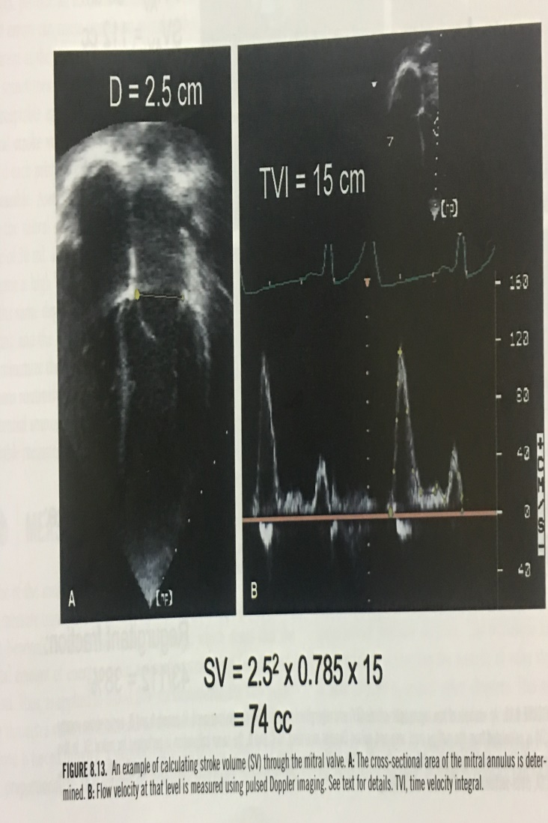
Mitral valve
Doppler mitral velocity can be determined by short axis view
Next an M-mode or 2D echo recording of mitral valve is used to determine mitral orifice diameter throughout diastole
A simplest approach uses the diameter of the mitral annulus as measured from the apical views as surrogate for CSA

Slide 64
Pulmonary valve
Sample volume positioned at the level of the pulmonary valve usually from the basal short axis view
In children subcostal view can be used
CSA measured as the diameter of outflow tract at the level of annulus
Accurate measurement is difficult in adults because of the challenges of visualizing the lateral border of RVOT

Slide 65
The shunt ratio is determined by calculating pulmonary stroke volume and comparing it with aortic SV.
The difference equals the net shunt volume in the absence of semilunar valve stenosis or regurgitation.

Slide 66
Contrast echocardiography
Intravenous contrast injection of saline remains one of the primary diagnostic tools for detecting an atrial septal defect and, in smaller defects, may provide crucial information as to the presence of a potential shunt that is not directly visualized or has not resulted in a right ventricular volume overload
When evaluating a patient for right to left shunt an agent that appears in the LV because of normal transpulmonary passage is not appropriate.

Slide 67
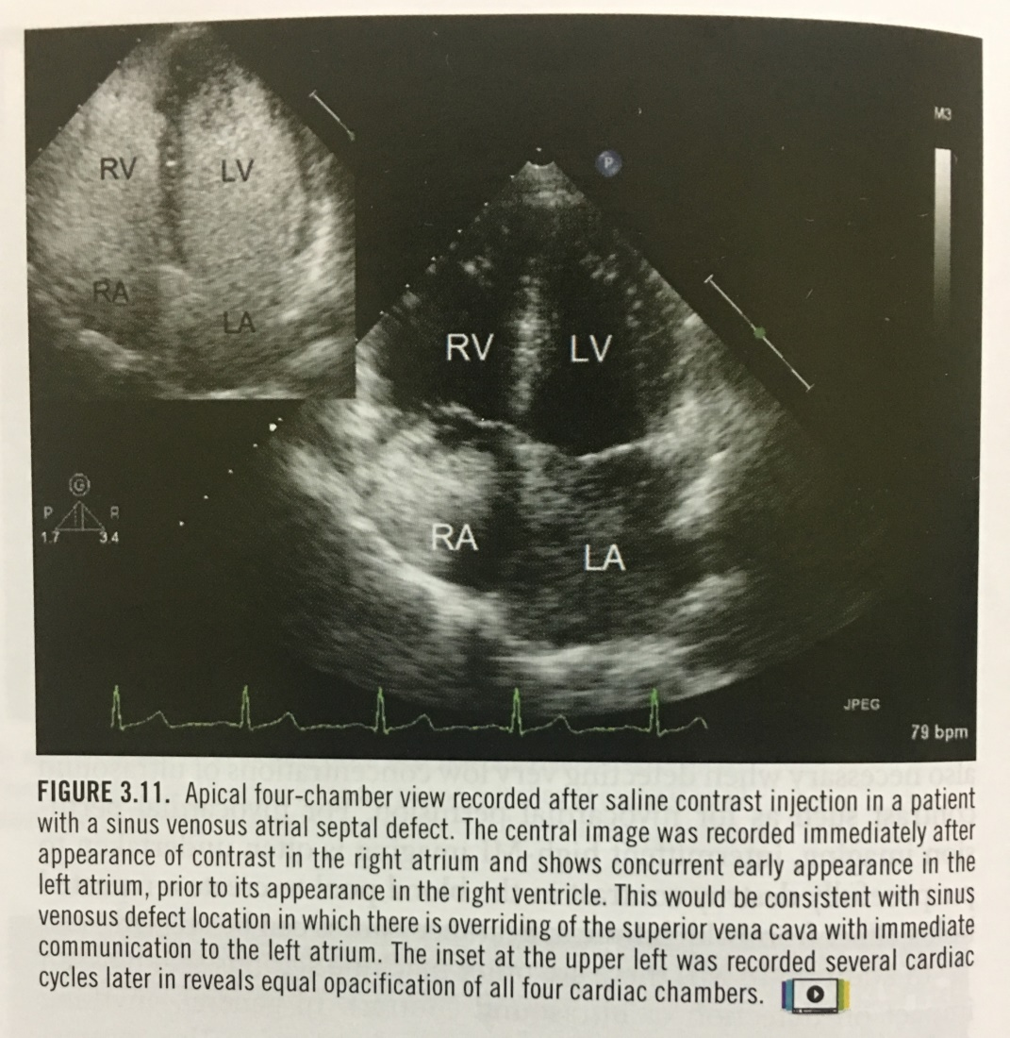

Slide 70
Thank you!

